Slide 1

Credit Card Fraud Detection System
Machine Learning Based Fraud Detection, Risk Prediction & Explainable AI
Submitted by
24B11IT097 — Sai Harini Singineedi
24B11IT072 — Nalli Praneesha
24B11IT083 — Pedapudi Snehalatha
25B21IT007 — Muralasetti Anantha Lakshmi
B.Tech Information Technology
Department of Information Technology, Aditya University
Academic Year: 2026–2027
Project Guide: Mrs. J. Divya Lalitha Sri

Slide 2
Introduction & Problem Statement
The Problem
Project Objectives
Credit card fraud causes financial losses for customers and financial institutions.
Fraudulent transactions can resemble legitimate transactions.
Large transaction volumes make manual monitoring difficult.
Fraud cases form a very small proportion of transactions.
False alerts create unnecessary investigation effort and customer inconvenience.
Develop a machine learning-based fraud detection system.
Engineer transaction, temporal, geographic, and behavioral features.
Train and compare Logistic Regression, Random Forest, and XGBoost.
Evaluate models using appropriate classification metrics.
Optimize the classification threshold.
Explain predictions using SHAP.
Build a web interface showing fraud probability, risk level, and contributing factors.
Illustrative: legitimate (blue) vs suspicious (amber)

Slide 3
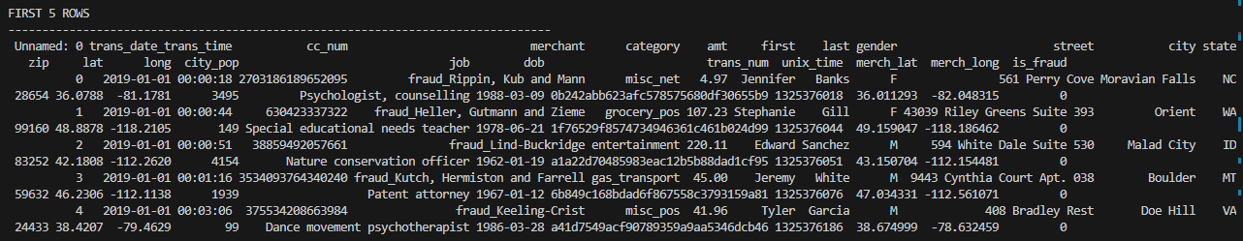
Dataset & Preprocessing
Preprocessing pipeline
Load and inspect the datasets.
Convert timestamps; sort chronologically.
Extract hour, day, month, day of week, weekend features.
Engineer age, merchant distance, previous transaction amount and count, historical average amount, time since previous transaction, amount deviation.
Encode merchant, category, state, gender (pandas categorical codes).
Fill numeric missing values with training-data medians.
Drop unnecessary columns.
Prepare 18 model input features.
Split | Total | Legitimate | Fraudulent
Train | 1,296,675 | 1,289,169 | 7,506
Test | 555,719 | 553,574 | 2,145
First 5 rows:

Slide 4
Model Development & Performance Comparison
Logistic Regression
Random Forest
XGBoost
Baseline linear classification model.
Benchmark for comparison.
Ensemble of decision trees.
Captures nonlinear patterns and feature interactions.
Gradient-boosting model.
Selected as the final model based on overall evaluation.
Test results at classification threshold 0.50
Metric | Logistic Regression | Random Forest | XGBoost
Precision | 27.19% | 99.08% | 95.88%
Recall | 8.53% | 40.33% | 68.34%
F1-score | 12.99% | 57.32% | 79.80%
ROC-AUC | 0.6305 | 0.9789 | 0.9949
PR-AUC | 0.0435 | 0.8200 | 0.8537
Precision: share of predicted fraud cases that were actually fraud.
Recall: share of actual fraud cases detected.
F1-score: harmonic mean of precision and recall.
ROC-AUC: class discrimination across thresholds.
PR-AUC: precision–recall trade-off; especially informative for imbalanced data.

Slide 5
Why We Selected XGBoost
Selection rationale
91.53%
72.54%
80.94%
Highest F1-score of the three models at threshold 0.50.
Highest ROC-AUC and PR-AUC.
Detected more fraudulent transactions than the others at the default threshold.
SHAP TreeExplainer supports interpretation of its predictions.
Trained with scale_pos_weight = 171.75 to handle class imbalance.
Precision @ 0.25
Recall @ 0.25
F1-score @ 0.25
Threshold optimization
Thresholds 0.10–0.90 were tested in steps of 0.05. 0.25 gave the highest F1-score among them — it is the selected operating threshold for this application, not a universally optimal one.
At threshold 0.25: TP 1,556 | TN 553,430 | FP 144 | FN 589

Slide 6
System Architecture
1 Raw Transaction Dataset
2 Preprocessing & Feature Engineering
3 Model Training & Evaluation
fraudTrain.csv
fraudTest.csv
Timestamp conversion, chronological sort
Temporal, geographic, behavioral features
Categorical encoding, missing values
Logistic Regression
Random Forest
XGBoost
4 Selected XGBoost Model
5 Application Layer
6 Prediction Output
Trained model artifacts
Classification threshold: 0.25
FastAPI backend
React frontend
Fraud probability
Risk classification
SHAP-based contributing factors
Note: the system is a local prototype. It is not connected to a live bank transaction processing system.

Slide 7
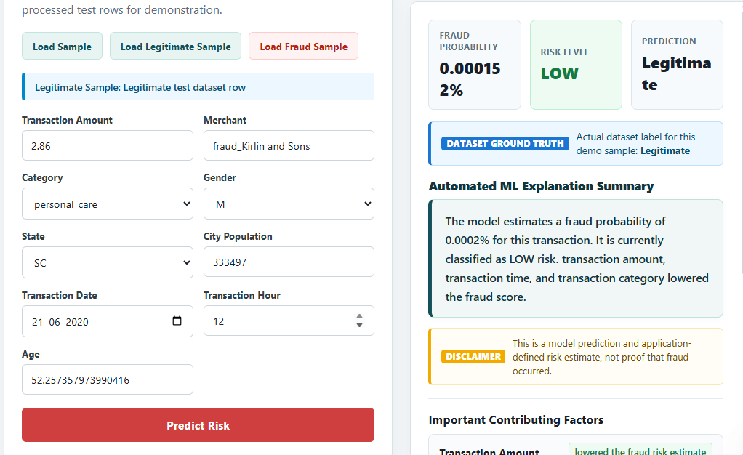
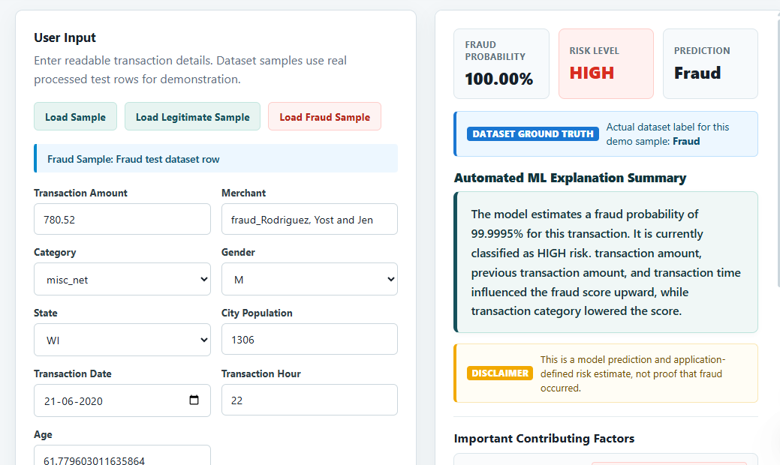
Implementation Workflow & Execution
Insert screenshot 1
Insert screenshot 2
Insert screenshot 4
Load Data → Preprocess → Engineer Features → Train Models → Evaluate → Optimize Threshold → Explain with SHAP → Predict through Web Application
Notes:
Insert the four screenshots over the dashed placeholders (Insert > Picture), then delete the "Insert screenshot" text/boxes behind them. Placeholders are named "Screenshot placeholder 1-4" in the Selection Pane.

Slide 8
Limitations & Future Scope
Current limitations
Future scope
Predictions are risk estimates, not definitive proof of fraud.
Behavioral features depend on available transaction history.
Manually entered transactions may lack complete historical context.
Real-world fraud patterns may differ from the dataset.
Fraud patterns can change over time.
The application is a local prototype, not a production banking deployment.
Integrate real-time transaction streams.
Add authentication and secure API communication.
Improve automatic historical feature generation.
Monitor model performance and data drift.
Retrain models as new transaction patterns emerge.
Explore richer behavioral analytics and additional models.
Deploy on scalable infrastructure after security and validation work.

Slide 9
Conclusion & Key Achievements
Data
End-to-end machine learning-based credit card fraud detection prototype.
Processed more than 1.29 million training transactions; compared three classification models.
Selected XGBoost based on F1-score, ROC-AUC, and PR-AUC.
Optimized the classification threshold to 0.25.
F1-score 80.94% and recall 72.54% at the optimized threshold.
Web interface showing fraud probability, risk level, and contributing factors.
SHAP used to make predictions more interpretable.
▼
Feature Engineering
▼
Model Comparison
▼
XGBoost @ 0.25
▼
SHAP Explanations
▼
Web Application
“This project combines machine learning, threshold optimization, and explainable AI to support informed credit card fraud risk assessment.”

Slide 10
THANK YOU
Questions & Answers
Credit Card Fraud Detection System
Department of Information Technology
Aditya University

